Slide 1
Psychological aspects of Seizures*
*(Epileptic and Non-epileptic)
S. Marc Testa, Ph.D.
Neuropsychology Fellow
Johns Hopkins University
Department of Psychiatry and Behavioral Sciences
Division of Medical Psychology
May 5, 2006
Notes:
The purpose of this study was to examine the psychological correlates of HRQOL among individuals with seizures.

Slide 2
Collaboration and Support
Epilepsy Foundation and the Gertrude A. Sergievsky Research Endowment
Collaborators
  Jason Brandt, Ph.D.
  Ronald P. Lesser, M.D.
  Nathan E. Crone, M.D.

Slide 3
Definition: Seizure
An unexpected and transient interruption of motor and sensory functioning.
Notes:
SLIDE SLIDE SLIDE SLIDE SLIDE SLIDE SLIDE SLIDE SLIDE

Slide 4
Broad Seizure Categories
Epileptic Seizures (ES)
  Manifestation(s) of epileptic (excessive and/or hypersynchronous), usually self-limited activity of neurons in the brain.
  ILAE Definition
Nonepileptic
  Paroxysmal events not associated with electroencephalographic changes.

Slide 5
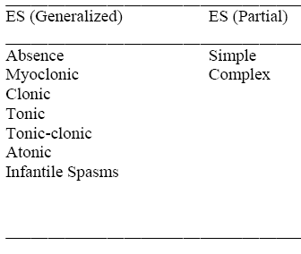
Epilepsy Classification

Slide 6
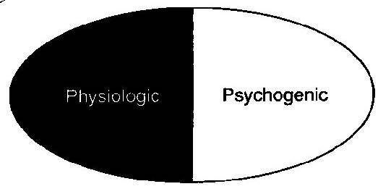
Nonepileptic Subtypes

Slide 7
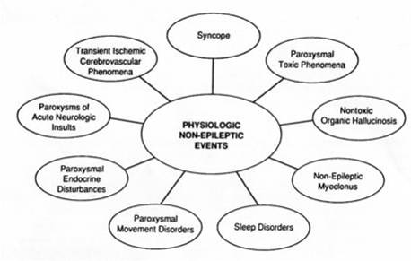
Physiologic Subtypes

Slide 8
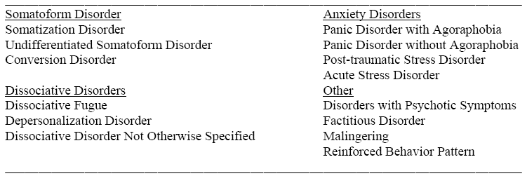
Psychogenic Seizures (PS)

Slide 9
General Perspective
Regardless of type, recurrent seizures disrupt daily functioning and can diminish an individual’s quality of life.
Psychogenic Seizures
  Can go undiagnosed for 7 to 9 years.
  Receive same medication as ES
  Have similar restrictions as ES (e.g., driving).
  May experience similar role limitations (e.g., social and occupational)

Slide 10
Epidemiology
2 million individuals have ES in United States
  About 25% of these have intractable seizures
5 – 25% of individuals treated yearly for seizures have PS
Incident rates
  ES: 24 – 53/100,000
  PNES: 1.5 – 3.03/100,000
Notes:
Just for illustrative purposes…. the Epidemiology of ES and PNES suggests that difficulties with HRQOL are widespread.
SLIDE SLIDE SLIDE SLIDE SLIDE SLIDE SLIDE SLIDE SLIDE
Moreover, lifetime healthcare costs have been estimated to be $200,000 per individual
Thus, research that focuses on improving HRQOL can have a, potentially, significant impact.

Slide 11
Why do psychological seizures occur?

Slide 12
Why do psychological seizures occur?
Benefits of the sick role?
  No work responsibilities
  Avoid relationship problems
  Avoid confrontation?
Where is the blame?
  Not on the person.
  On the illness.
Illness behavior without a broken body part.

Slide 13
Inclusion Criteria
Definite Diagnosis
  ES
    Simultaneous occurrence of a stereotypic event and abnormal EEG changes.
  PS
    Habitual event recorded on video/EEG with normal EEG.
Notes:
When these were not clearly determined the individual was excluded from the study.
IF ASKED:………………
Possible PNES was assigned when no habitual events were recorded and interictal EEG activity was continuously normal.
Possible ES was used when no habitual events were recorded, but interictal EEG activity was positive for abnormalities.

Slide 14
Participants
All participants were undergoing comprehensive video/EEG monitoring for intractable seizures
Medication has not been effective in controlling seizures
Notes:
All have failed medication trials

Slide 15
Exclusion Criteria
< 18-years-old
Full Scale IQ (FSIQ) < 70
Incomplete neuropsychological battery
No MMPI-2
An invalid MMPI-2
  Lie scale score greater than a T-score of 65
  F minus K raw score (Infrequency Scale – Correction Scale) greater than or equal to 15

Slide 16
Measure: Mood
Profile of Mood States (POMS)
  A measure of mood symptoms
  An overall score of Total Mood Disturbance (TMD) can be calculated
Notes:
6 Subscales: Fatigue/Inertia, Anger/Hostility, Vigor/Activity, Confusion/Bewilderment, Depression/Dejection, Tension/Anxiety.
HYPOTHESIS 2

Slide 17
Measure: Personality
Minnesota Multiphasic Personality Inventory-2
  Very widely used measure of general personality and psychopathology
  Based on the ES and PS literature, subscales of interest were used in the current study
Notes:
Hypothesis 3

Slide 18
Neurocognitive Constructs
Neurocognitive constructs were developed from a comprehensive test battery
  Attention/Concentration
  Verbal Memory Retention
  Language
  Processing Speed
  Executive Functioning
Notes:
I used a method of data reduction that takes of a comprehensive neuropsychological test battery that utilizes multiple psychometrically sound measures of a variety of neurocognitive domains.
All measures included:
Were widely available
Have acceptable psychometric qualities
Have widespread clinical and research use in populations undergoing a comprehensive epilepsy evaluation
IF ASKED….
This composite building technique produces robust theory-based constructs via a series of iterative empirical steps.
Minimizes Type I error by reducing the number of analyses and improving the participant to variable ratio.
Allows for direct comparisons between tests and reflects performance based on normative information.
The series of empirical procedures used to develop the neurocognitive domains are as follows.
First, an experienced neuropsychologist familiar with neuropsychological assessment in a comprehensive epilepsy program designed the entire test battery.
Second, the neuropsychological battery contained measures with appropriate psychometric properties and demographically corrected normative data.
Third, subscales and measures were assigned to each of five neurocognitive domains by three neuropsychologists. Only measures with 3 out of 3 agreement (100%) were included.
Fourth, the fit of the indicators to the construct was examined with a factor analysis confined to a single solution for each neurocognitive domain. Only indicators with factor loadings >.3 were retained and included in the construct.

Slide 19
Demographic Variables
ES (N=69) PS (N=45)
Variable M SD M SD
Age 35.90 10.68 37.42 9.89
Education 12.96 2.15 12.47 1.10
Full Scale IQ 88.96 13.26 89.93 8.47
Discrete variables ES PS OR
Sex (% male) 44.9 31.1 1.81
Psychiatric History (% Y) 34.8 60.0 2.81
(CI = 1.30-6.11)
p < .01
OR = Odds Ratio
Notes:
HRQOL in the current sample is in line with some other studies outside our research group….however, 65.5 has been reported in development studies that looked at outpatient samples.

Slide 20
Seizure Related Variables
ES (N=69) PS (N=45)
Variable M SD M SD
Age at Seizure Onset 18.75 15.51 30.31 11.75
Seizure Duration (years) 15.63 12.85 6.61 8.98
No. Seizures/week 6.67 13.57 10.87 12.53
No. Current AEDs 1.88 0.94 1.09 0.79
p<.001

Slide 21
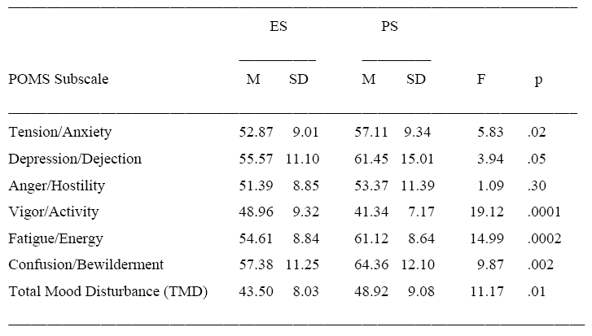
Mood Variables
Due to multicollinearity among the POMS variables, TMD was used as an indicator of mood state.

Slide 22
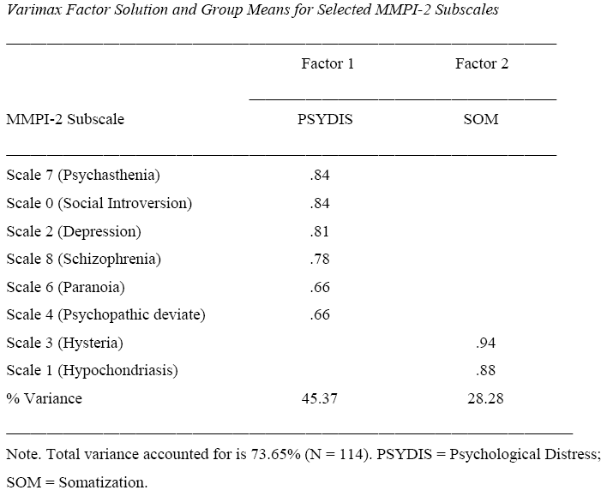

Slide 23
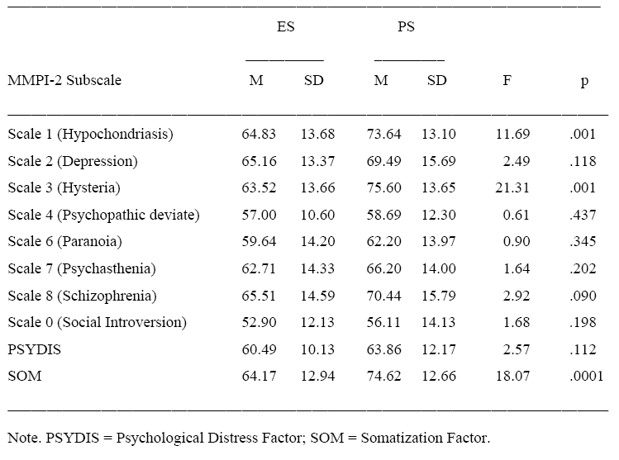

Slide 24
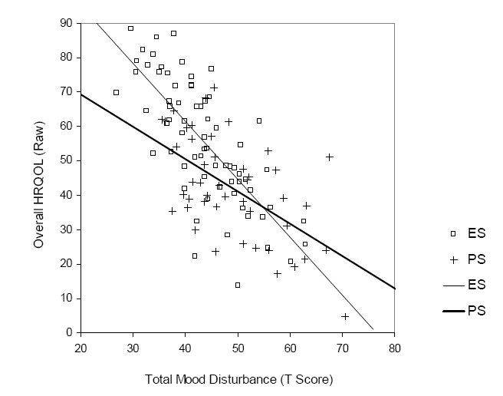

Slide 25
Mood, Personality, and HRQOL
Variable B SE β ΔR²
SZDX* -4.858 2.433 -.132 .087***
PSYHX -.097 2.403 -.003 .109***
TMD*** -0.761 0.170 -.371 .340***
PSYDIS** -0.490 0.146 -.299 .068***
SOM** -0.277 0.094 -.211 .030**
Total R² = .634 Adjusted R² = .617
*p<.05; **p < .01; ***p < .001
Interaction terms were not significant and were not included in this table.

Slide 26
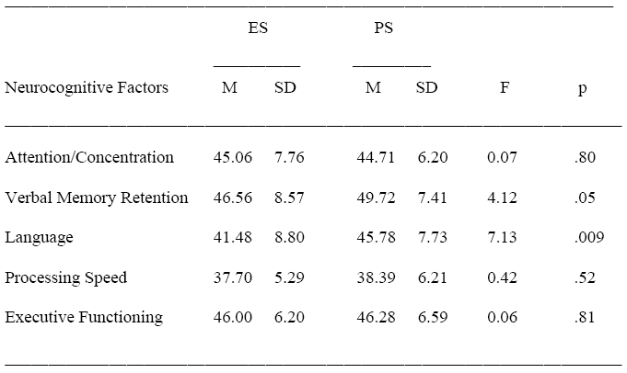
Neurocognitive Constructs
MANOVA was not significant (p=.09)

Slide 27
Ongoing Research
Epilepsy Foundation Study
  Mood and psychopathology in patients with Epilepsy OR Psychogenic seizures.
  Inpatients
  Similar exclusion/inclusion criteria as prior study.
  However, different measures of psychopathology are being employed.
  PAI, NEO, QOLIE-31, Implicit Association Test

Slide 28
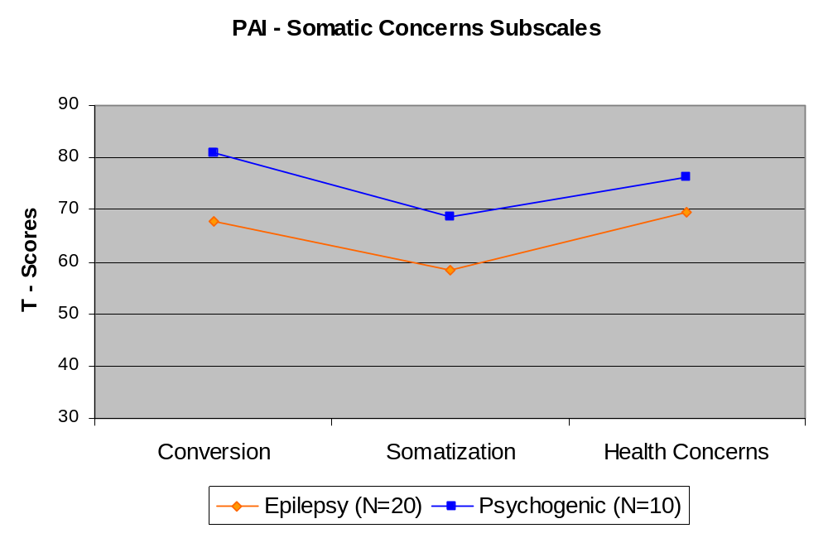
PAI – Somatic Concerns Subscales
p = .02 p = .04 p = .18

Slide 29
Conversion Subscale Items
My health condition has restricted my activities.
I've had illnesses that my doctors could not explain.
I've had numbness in parts of my body that I can't explain.
I've had episodes of double vision or blurred vision.
There have been times when my eyesight got worse and then better again.
I've had episodes when I've lost the feeling in my hands.
I've had times when my legs became so weak that I couldn't walk.
At times parts of my body have been paralyzed.

Slide 30
Somatization Subscale Items
Much of the time I don't feel well.
I suffer from a lot of pain.
I am in good health.
I seldom have complaints about how I feel physically.
I have a bad back.
I have a weak stomach.
I get more headaches than most people.
I frequently have diarrhea.

Slide 31
Health Concerns Subscale
I've seen a lot of doctors over the years.
My health problems are very complicated.
It's a struggle for me to get things done with the medical problems I have.
My medical problems always seem to be hard to treat.
I've had only the usual health problems that most people have.
I've had some unusual diseases and illnesses.
For my age, my health is pretty good.
I like to talk with people about their medical problems.

Slide 32
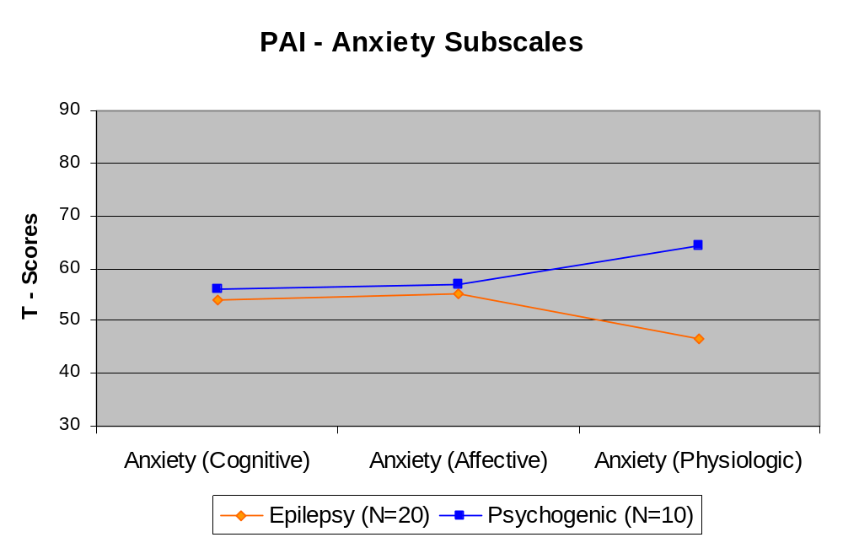
PAI – Anxiety Subscales
p = .53 p = .48 p = .01

Slide 33
Anxiety – Physiological Symptoms
I often feel jittery.
I worry so much that at times I feel like I am going to faint.
Sometimes I feel dizzy when I've been under a lot of pressure.
I can often feel my heart pounding.
It's easy for me to relax.
When I'm under a lot of pressure, I sometimes have trouble breathing.
I get sweaty hands often.
I have very steady hands.

Slide 34
Anxiety – Affective
I am so tense in certain situations that I have great difficulty getting by.
I can't do some things well because of nervousness.
Sometimes I am afraid for no reason.
I'm not the kind of person who panics easily.
I am a very calm and relaxed person.
I often feel as if something terrible is about to happen.
I seldom feel anxious or tense.
I am easily startled.

Slide 35
Anxiety - Cognitive
I often have trouble concentrating because I'm nervous.
It's often hard for me to enjoy myself because I am worrying about things.
I'm often so worried and nervous that I can barely stand it.
My friends say I worry too much.
I don't worry about things any more than most people.
I don't worry about things that I can't control.
I usually worry about things more than I should.
Sometimes I get so nervous that I'm afraid I'm going to die.

Slide 36
?

Slide 41
HRQOL
A subjective measure
Looks at the the impact of disease and treatment on an individual’s “life” functioning…
Thus, HRQOL in epilepsy is not just concerned with seizure frequency and reduction.
Notes:
SO what is HRQOL?
SLIDE SLIDE SLIDE SLIDE SLIDE SLIDE SLIDE SLIDE SLIDE …..
SLIDE SLIDE SLIDE SLIDE SLIDE SLIDE SLIDE SLIDE SLIDE
Dimensions of HRQOL include…..
Physical functioning
Psychological functioning
Social functioning
Cognitive functioning
General well-being

Slide 42
  “The patient is the only one who knows how he or she feels, how the disorder affects that person’s vigor, self-confidence, ability to socialize, obtain work, and function at home and on the job.”
  Devinsky & Cramer, 1993 (Epilepsia)
Notes:
HRQOL is an important issue because it places an emphasis on the difficulties that individuals with seizures face on a daily basis and does so by taking the patients perspective into consideration.

Slide 43
Psychological Factors Related to HRQOL
Mood symptoms
Personality traits
Neurocognitive dysfunction
These relationships have been demonstrated in Schizophrenia, HIV, Multiple Sclerosis.
Notes:
SPECIFIC FACTORS THAT ARE ASSOCIATED WITH POOR HRQOL INCLUDE…
Mood symptoms
Personality traits
Neurocognitive dysfunction
These have been linked to HRQOL in other patient groups.
These have all been shown to be problematic among individuals with seizures.

Slide 44
Domains of HRQOL in Epilepsy:
QOLIE-89 Factor Analysis
Epilepsy Targeted
  Seizure Worry
  Medication effects
  Health Discouragement
  Work/Driving/Social Function
Cognitive
  Memory
  Attention
  Language

Slide 45
QOLIE-89 Domains (con’t)
Mental Health
  Emotional Well-being
  Role limitations; emotional
  Social Isolation
  Social Support
  Energy/Fatigue
Physical Health
  Health Perceptions
  Physical Function
  Pain

Slide 46
QOLIE-89: ES vs. PS
Several reports show that individuals with PS rate their HRQOL more poorly than those with ES
Breier et al., 1998
Loring, Meador, King, & Hermann, 2000
Szaflarski, Szaflarski et al., 2003
These differences have been partially explained by mood symptoms (i.e., moderation).
Szaflarski, Hughes et al., 2003
Notes:
Several reports show the difference….
The current literature shows that these diff are partially explained by mood

Slide 47
However…
Although, personality and neurocognitive functioning have been linked to HRQOL in other patient populations
These not been fully examined in explaining the differences between groups among individuals with seizures.
  I.e., ES vs. PS

Slide 48
Clinical Research Questions
In addition to mood, can HRQOL differences between ES and PS be explained by psychological variables?
Notes:
I wanted to examine if the data we collect could add to what we already understand with regard to mood and HRQOL in a combined ES and PNES sample.
THUS…..
SLIDE SLIDE SLIDE

Slide 49
Specific Hypotheses
Hypothesis 1
  Individuals with PS will report poorer overall HRQOL than those with ES.
Hypothesis 2
  Greater mood symptoms will be associated with lower HRQOL above and beyond the variance that is accounted for by seizure diagnosis.
Notes:
I developed 4 hypotheses to test,
To assess the consistency with available research…
SLIDE SLIDE SLIDE SLIDE SLIDE SLIDE SLIDE SLIDE SLIDE SLIDE SLIDE SLIDE

Slide 50
Specific Hypotheses
Hypothesis 3
  Elevated personality factors will be associated with poorer HRQOL above and beyond the variance that is accounted for by seizure diagnosis.
Hypothesis 4
  Poorer neurocognitive functioning will be associated with a lower HRQOL beyond what is accounted for by seizure diagnosis.
Notes:
These hypotheses are specific to personality factors and neurocognitive functioning
SLIDE SLIDE SLIDE SLIDE

Slide 51
Dependent Measure: HRQOL
QOLIE-89
  A composite score representing “Overall HRQOL” was used as the dependent variable
  Higher scores reflect better HRQOL ratings (100 point scale)
Notes:
Quality of Life in Epilepsy Inventory-89 this is a self report instrument
HIGHER IS BETTER
Widely use and well accepted epilepsy-specific measure of HRQOL.

Slide 52
Statistical Analyses
Multiple regression analyses were used to examine the validity of each hypothesis
Unstandardized beta weight for seizure diagnosis are used to:
  determine how much of the HRQOL difference between groups is explained by the added predictor variables.

Slide 53
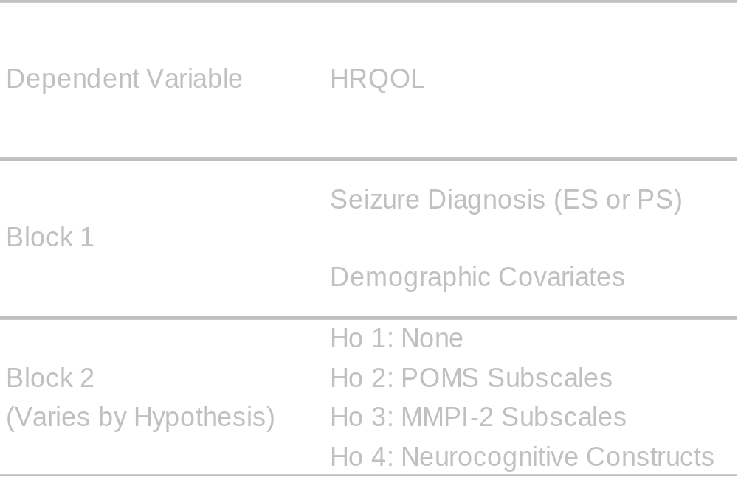
Hierarchical Regression

Slide 54
Equations
Hypothesis 1 = Seizure Diagnosis + Demographic covariates
Hypothesis 2 = Seizure Diagnosis + Demographic covariates + Total Mood Disturbance
Hypothesis 3 = Seizure Diagnosis + Demographic covariates
+ MMPI-2 Subscales
Hypothesis 4 = Seizure Diagnosis + Demographic covariates + Neurocognitive Constructs

Slide 55
Seizure Related Variables
ES (N=69) PS (N=45)
Variable M SD M SD
Age at Seizure Onset 18.75 15.51 30.31 11.75
Seizure Duration (years) 15.63 12.85 6.61 8.98
No. Seizures/week 6.67 13.57 10.87 12.53
No. Current AEDs 1.88 0.94 1.09 0.79
p<.001

Slide 56
Hypothesis 1: Means
ES PS
Variable M SD M SD
HRQOL (QOLIE-89)* 55.70 18.05 42.15 14.97
*p < .001
The difference between the means is 13.55

Slide 57
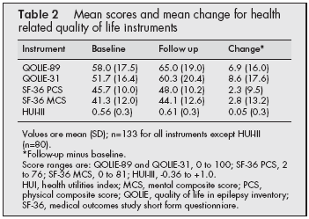
(Wiebe et al., 2002)

Slide 58
Hypothesis 1 and Covariates
Variable B SE β R² Adj. R2
Block 1 .135*** .127
SZDX*** -13.55 3.239 -.368
Block 2 (ΔR2 = .084*) .219*** .183
SZDX* -8.252 3.690 -.224
PSYHX** -9.255 3.226 -.255
Age of Seizure Onset -0.104 0.137 -.087
Number of AEDs 0.335 0.640 .058
Duration of seizures (yrs) 0.083 0.177 .058
*p<.05; **p < .01; ***p < .001
Notes:
Reiterate hyp 1
WARN THEM….

Slide 59
Hypothesis 2: Mood
Variable B SE β R² Adj. R²
Block 1 .196*** .181
SZDX** -11.226 3.238 -.305
PSYHX** -9.218 3.183 -.254
Block 2 (ΔR² = .368***) .564 .548
SZDX* -6.313 2.495 -.171
PSYHX -3.085 2.451 -.085
TMD *** -1.347 0.142 -.657
TMD x SZDX* 0.717 0.274 .169
*p<.05; **p < .01; ***p < .001
Notes:
SZDX = seizure diagnosis
PSYHX = Psychiatric History
TMD = total mood disturbance…contains all subscales of the POMS

Slide 60
Hypothesis 3: Personality
Variable B SE β R² Adj. R²
Block 1 .196*** .181
SZDX** -11.226 3.238 -.305
PSYHX** -9.218 3.183 -.254
Block 2 (ΔR² = .391***) .586 .563
SZDX** -7.880 2.574 -.214
PSYHX 0.826 2.587 .023
PSYDIS*** -0.940 0.130 -.574
SOM** -0.289 0.100 -.220
PSYDIS x SZDX* 0.491 0.233 .151
SOM x SZDX -0.019 0.204 -.007
*p<.05; **p < .01; ***p < .001
Notes:
PSYDIS = psychological distress factor …contains
Scale 7 (Psychasthenia)
Scale 0 (Social Introversion)
Scale 2 (Depression)
Scale 8 (Schizophrenia)
Scale 6 (Paranoia)
Scale 4 (Psychopathic deviate)
SOM = Somatization Factor
Scale 3 (Hysteria)
Scale 1 (Hypochondriasis)

Slide 61
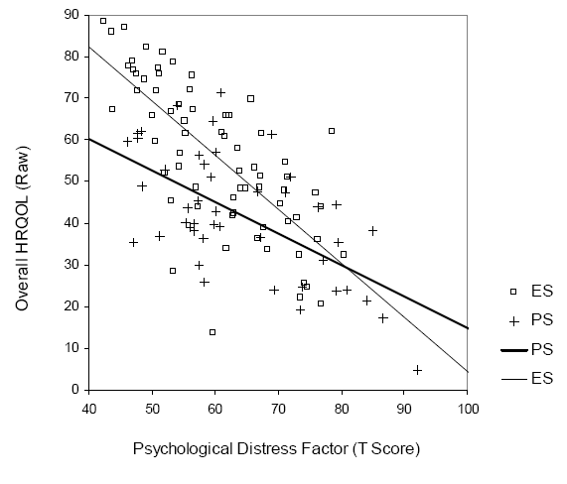

Slide 62
Mood, Personality, and HRQOL
Variable B SE β ΔR²
SZDX* -4.858 2.433 -.132 .087***
PSYHX -.097 2.403 -.003 .109***
TMD*** -0.761 0.170 -.371 .340***
PSYDIS** -0.490 0.146 -.299 .068***
SOM** -0.277 0.094 -.211 .030**
Total R² = .634 Adjusted R² = .617
*p<.05; **p < .01; ***p < .001
Interaction terms were not significant and were not included in this table.

Slide 63
Hypothesis 4:
Neurocognitive Functioning and HRQOL
None of the neurocognitive constructs were significantly predictive of HRQOL
This was true when separate regressions were run for each group.

Slide 64
Conclusions
Total mood disturbance moderates the relationship between HRQOL and seizure diagnosis.
Aspects of psychological distress and somatization are significantly associated with HRQOL.
Personality factors may explain the moderating effect of mood.

Slide 65
Conclusions
Neurocognitive functioning does not appear to be related to HRQOL.
The results of this study have implications for the treatment of HRQOL difficulties among individuals who require comprehensive video/EEG monitoring.

Slide 66
Thanks to…
Bruce K. Schefft, Ph.D.
Christine Hovanitz, Ph.D.
Steven R. Howe, Ph.D.
Robert M. Stutz, Ph.D.
Jerzy P. Szaflarski, M.D., Ph.D.
Notes:
I just want to thank you all for being here

